Slide 1
Cloning Vectors in Bacteria Plasmids and Phages
Bacterial Strains and Plasmid Vectors

Slide 2
Bacteria as hosts eg.- Eschericia coli, Bacillus subtilis
They are easily grown
They are cheap to grow
They grow fast
They are easily manipulated in the laboratory
DNA can be inserted - transformation
DNA can be easily isolated
Non-pathogenic
Genetically stable
Bacteria contain natural plasmids and viruses which are useful vectors for recombinant DNA
Equipped with appropriate enzymes to allow replication of the vector
Notes:
http://www.unife.it/scienze/biologia/Insegnamenti/tecnologie-ricombinanti/tecnologie-ricombinanti-2017/4-plasmidi.pdf

Slide 3
Bacterial Engineered Host Strains
A few mutations are common to all or most expression strains to accommodate high protein levels including:
ompT: Strains harboring this mutation are deficient in outer membrane protease VII, which reduces proteolysis of the expressed recombinant proteins.
lon protease: Strains where this is completely deleted (designated lon or Δlon) similary reduce proteolysis of the expressed proteins. hsdS_{B} (r_{B}⁻ m_{B}⁻): These strains have an inactivated native restriction/methylation system. This means the strain can neither restrict nor methylate DNA.
Dcm/Dam: Similarly, strains with this mutation are unable to methylate cytosine/adenine within a particular sequence.
Notes:
Source- https://blog.addgene.org/plasmids-101-e-coli-strains-for-protein-expression

Slide 4
Commonly Used Bacterial Strains
Strain | Resistance | Key Features | Use
BL21 (DE3) |  | Basic IPTG-inducible strain containing T7 RNAP (DE3) | General protein expression
BL21 (DE3) pLysS* | Chloramphenicol (pLysS) | pLysS expresses T7 lysozyme to reduce basal expression levels; expression vector cannot have p15A origin of replication | Expression of toxic proteins
BL21 (DE3) pLysE* | Chloramphenicol (pLysE) | pLysE has higher T7 lysozyme expression than pLysS; expression vector cannot have p15A origin of replication | Expression of toxic proteins
BL21 star (DE3) |  | Lacks functional RNaseE which results in longer transcript half-life | General expression; not recommended for toxic proteins
BLR (DE3) | Tetracycline | RecA-deficient; best for plasmids with repetitive sequences. | Expression of unstable proteins
Notes:
* Denotes the presence of an additional plasmid-- make sure to maintain this by growing on appropriate media. Note: Purifying your expression plasmid from these strains is not recommended as these auxillary plasmids may be isolated during the prepping process.
Source- https://blog.addgene.org/plasmids-101-e-coli-strains-for-protein-expression
Bacteriophage T7 lysozyme, a natural inhibitor of T7 RNA polymerase, can reduce basal activity from an inducible gene for T7 RNA polymerase and allow relatively toxic genes to be established in the same cell under control of a T7 promoter. Low levels of T7 lysozyme supplied by plasmids pLysS or pLysL, which are compatible with the pET vectors for expressing genes from a T7 promoter, are sufficient to stabilize many target plasmids and yet allow high levels of target protein to be produced upon induction of T7 RNA polymerase.
Different configurations of the expression system can maintain several different steady-state levels of target gene expression. The presence of T7 lysozyme has the further advantage of facilitating the lysis of cells in preparing extracts for purification of target gene products.

Slide 5
Bacterial Strains
Strain | Resistance | Key Features | Use
Origami2 (DE3)** | Streptomycin and Tetracycline | Contains highly active thioredoxin reductase and glutathione reductase to faciliate proper folding; may increase multimer formation | Expression of insoluble proteins
Rosetta2 (DE3)* | Chloramphenicol (pRARE) | Good for “universal” translation; contains 7 additional tRNAs for rare codons not normally used in E. coli. Expression vector cannot have p15A origin of replication | Expression of eukaryotic proteins
Lemo21 (DE3)* | Chloramphenicol (pLemo) | Rhamnose-tunable T7 RNAP expression alleviates inclusion body formation. Expression vector cannot have p15A origin of replication | Expression of toxic, insoluble, or membrane proteins
Notes:
* Denotes the presence of an additional plasmid-- make sure to maintain this by growing on appropriate media. Note: Purifying your expression plasmid from these strains is not recommended as these auxillary plasmids may be isolated during the prepping process.
Source- https://blog.addgene.org/plasmids-101-e-coli-strains-for-protein-expression

Slide 6
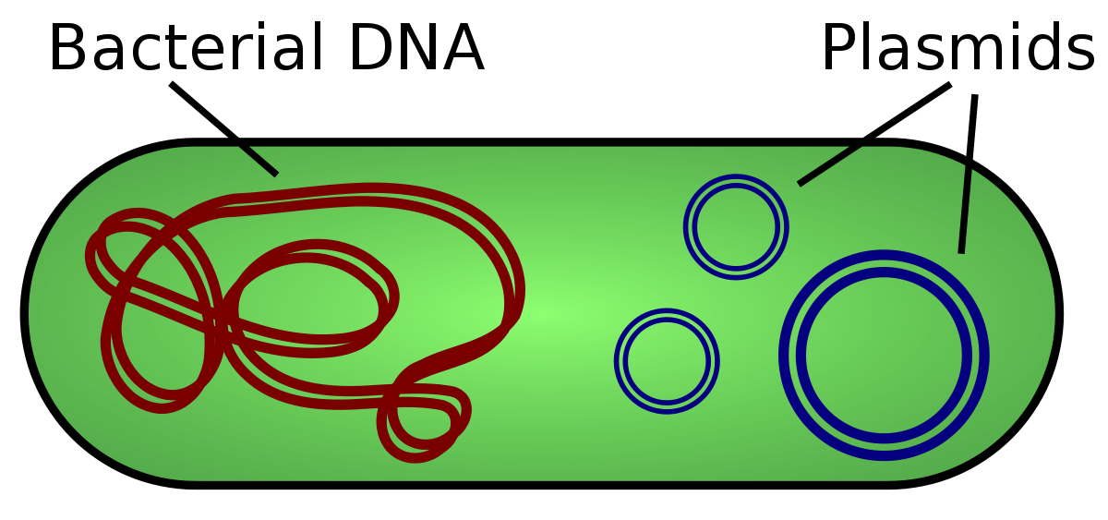
Plasmids

Slide 7
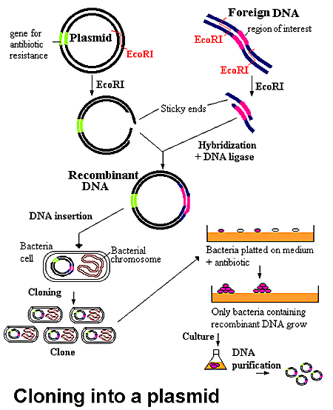

Slide 8
Plasmids- Small circular piece of extrachromosomal DNA
Circular and linear (Streptomyces sp, Borrelia burgdoferi)
Plasmids are classified
1. by their ability to be transferred to other bacteria (+ce of tra genes)
Conjugative The sexual transfer of plasmids to another bacterium through a pilus. those plasmids possess the 25 genes required for transfer
Non-conjugative Non-conjugative plasmids don’t initiate conjugaiton.

Slide 9
PLASMID CLASSIFICATION BY FUNCTION
1. Fertility-(F) plasmids,
They are capable of conjugation (they contains the genes for the pili).
Resistance-(R) plasmids,
contain gene (s) that can build resistance against one or several antibiotics or poisons.
Col-plasmids,
contain genes coding for colicines, proteins that can kill other bacteria
.
Degradative plasmids,
able to digest unusual substances, e.g., toluene or salicylic acid.
Virulence plasmids,
turn a bacterium into a pathogen.

Slide 10
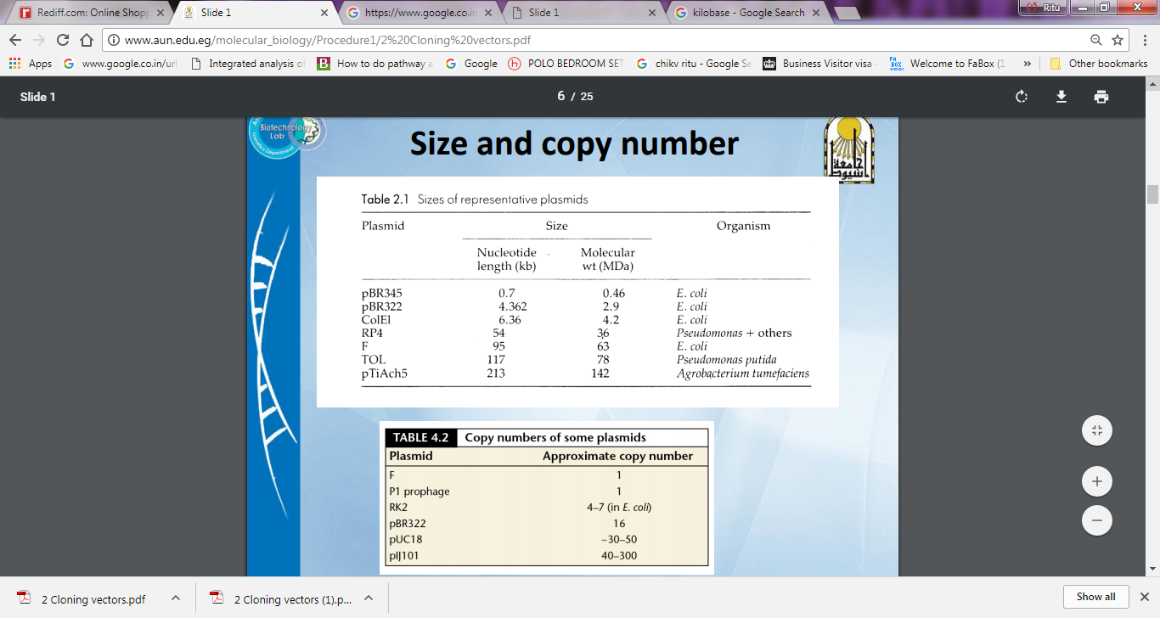
3. Size and Copy number
High copy number = 10-300 copies / cell → generally Non conjugative, relaxed
Low copy number = 1-4 copies / cell → generally conjugative, HMW, stringent
Notes:
Closely related or identical plasmids demonstrate incompatibility; they cannot be stably maintained in the same bacterial host. Conjugative plasmids code for functions that promote transfer of the plasmid from the donor bacterium to other recipient bacteria, but nonconjugative plasmids do not. Conjugative plasmids that also promote transfer of the bacterial chromosome from the donor bacterium to other recipient bacteria are called fertility plasmids. The average number of molecules of a given plasmid per bacterial chromosome is called its copy number. Large plasmids (>40 kilobase pairs) are often conjugative, have small copy numbers (1 to several per chromosome), code for all functions required for their replication, and partition themselves among daughter cells during cell division in a manner similar to the bacterial chromosome. Plasmids smaller than 7.5 kilobase pairs usually are nonconjugative, have high copy numbers (typically 10–20 per chromosome), rely on their bacterial host to provide some functions required for replication, and are distributed randomly between daughter cells at division.

Slide 11
Copy number
Regulated by initiation of plasmid replication
Antisense RNA
Proteins binding to repeated sequences called iterons

Slide 12
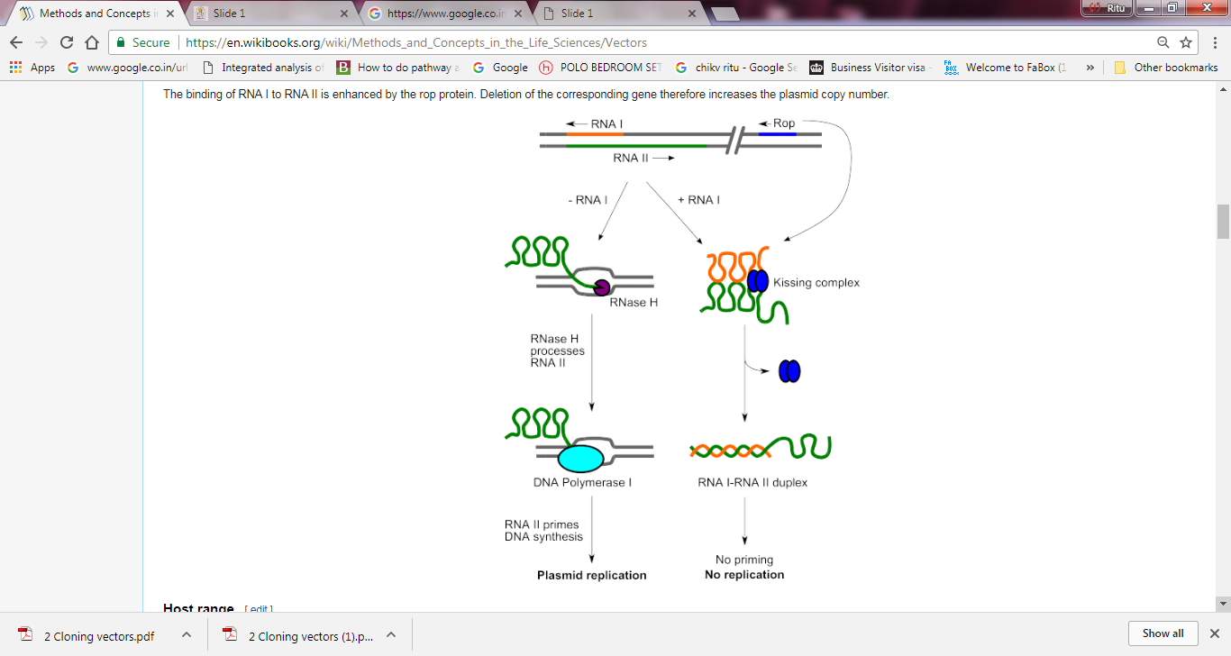
Control of Copy number (Replication Initiation control)
Notes:
In ColE1 derived plasmids, replication is primarily regulated through a small plasmid-encoded RNA called RNA I. A single promoter initiates replication in ColE1: the RNA II promoter. ColE1 replication begins at the origin. 555bp upstream from this point, RNA polymerase initiates transcription of RNAII which acts as a pre-primer and begins the synthesis of the leader strand. The RNAII transcript folds into a secondary structure which stabilises the interaction between the nascent RNA and the origin's DNA. The RNA II transcript forms a stable RNA-DNA hybrid with the DNA template strand near the origin of replication, where it is then processed by RNaseH to produce the 3' OH primerthat DNA polymerase I uses to initiate leading strand DNA synthesis. RNA I serves as a major plasmid-encoded inhibitor of this process whose concentration is proportional to plasmid copy number. RNA I is exactly complementary to the 5' end of the RNA II (because it is transcribed from the opposite strand of the same region of DNA as RNA II). RNA I and RNA II first form a weak interaction called a kissing complex. The kissing complex is stabilized by a protein called Rop (repressor of primer) and a double-stranded RNA-I/RNA-II RNA duplex is formed. This altered shape prevents RNA II from hybridizing to the DNA and being processed from RNaseH to produce the primer necessary for initiation of plasmid replication. More RNA I is produced when the concentration of the plasmid is high, and high concentration of RNA I inhibits replication, resulting in regulation of copy number.^{[2][3]}RNAI is under control of a constitutive promoter.
Deletion ropI increases copy number. The formation of an RNA-RNA duplex is stabilized by a plasmid-borne protein, Rop. Rom (the gene encoding Rop) has been removed in most vectors, which raises plasmid copy number by 3 to 5-fold

Slide 13
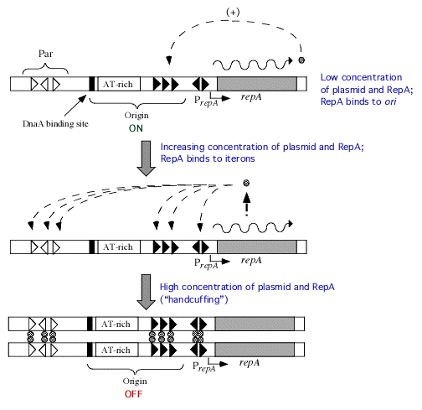
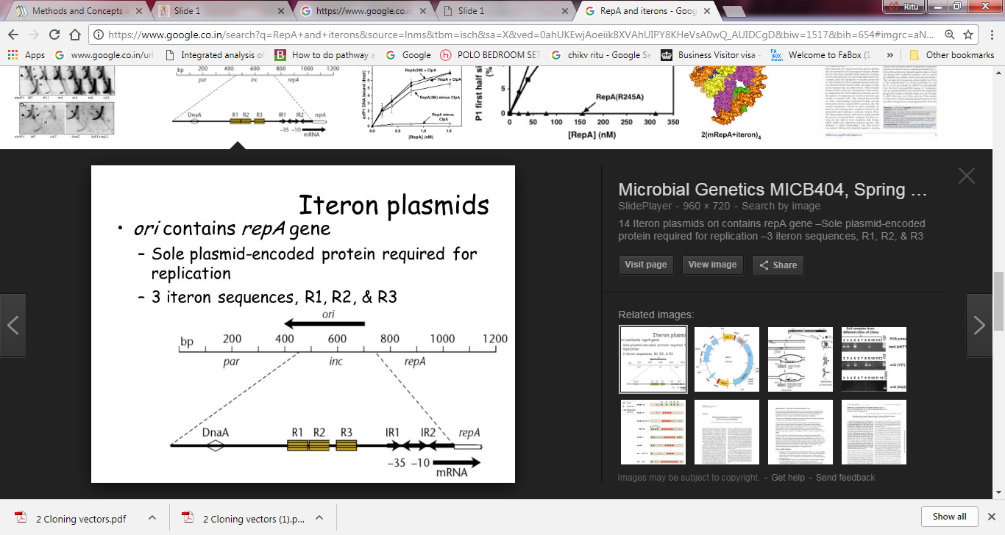
Control of Copy number (Replication Initiation control)
Autoinhibition
Handcuffing plasmids (RepA)
Notes:
Iteron plasmids, including F and RK2-related plasmids, have oriV regions containing multiple (~3-7) repeats of 17-22 bp iteron sequences.^{[3]} pSC101 represents a simple model of an iteron plasmid. Iteron plasmids control copy number through two combined methods, suitable for low copy number stringent plasmids. One method is control of RepA synthesis. RepA is the only plasmid-encoded protein required for replication in pSC101. RepA protein represses its own synthesis by binding to its own promoter region and blocking transcription of itself (transcriptional autoregulation). Thus, the more RepA is made, the more its synthesis is repressed, and subsequently limiting plasmid replication.^{[3]} The coupling hypothesis proposes that the second method is coupling of plasmids through the Rep protein and iteron sequences. When the plasmid concentration is high, RepA plasmids bound to iterons form dimers in between two plasmids, "handcuffing" them at the origin of replication and inhibiting replication.^{[6]}

Slide 14
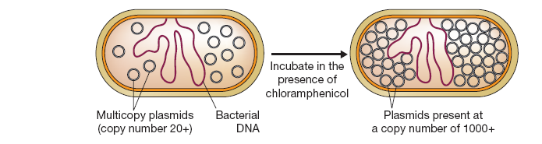
PLASMID AMPLIFICATION
Notes:
The aim of amplification is to increase the copy number of a plasmid. Some multicopy
plasmids (those with copy numbers of 20 or more) have the useful property of
being able to replicate in the absence of protein synthesis. This contrasts with the main
bacterial chromosome, which cannot replicate under these conditions. This property
can be utilized during the growth of a bacterial culture for plasmid DNA purification.
After a satisfactory cell density has been reached, an inhibitor of protein synthesis
(e.g., chloramphenicol) is added, and the culture incubated for a further 12 hours.
During this time the plasmid molecules continue to replicate, even though chromosome
replication and cell division are blocked (Figure 3.17). The result is that plasmid copy
numbers of several thousand may be attained. Amplification is therefore a very efficient
way of increasing the yield of multicopy plasmids.

Slide 15
Plasmid replication
Must be a self-replicating genetic unit
Plasmid DNA must replicate every time host cell divides or it will be lost
All self replication plasmids have a ori: origin of replication → it determines host and copy number.
Plasmid segregation is maintained by a par locus-a partition locus that ensures each daughter cells gets one plasmid. Not all plasmids have such sequences. Essential for low copy number plasmids.

Slide 16
Stringent
Plasmids are said to be under stringent control of replication when they are dependent on the presence of initiation proteins synthesized by the host cell in order to start their own replication. In general, these types of plasmids tend to be low copy number.
Relaxed
Conversely, plasmids that can initiate DNA replication independently of the host's initiation proteins are said to be under relaxed control, as they only require the host's replication machinery for elongation and termination. These types of plasmids tend to be high copy number.
Notes:
https://blog.addgene.org/plasmids-101-stringent-regulation-of-replication

Slide 17
INCOMPATIBILITY GROUPS:
Plasmid incompatibility refers to the inability of two plasmids to coexist stably over a number of generations in the same bacterial cell line. Generally, closely related plasmids tend to be incompatible, while distantly related plasmids tend to be compatible.
How do you know if your plasmids are incompatible?
Scientists have developed a system of bacterial incompatibility groups based on similarity of replication and partitioning systems where the plasmids belonging to the same group are incompatible.
Using plasmid incompatibility for therapeutic advantage-
Although it may seem like plasmid incompatibility may be standing in your way to bacterial cloning glory, scientists have applied these concepts to deal with the more sinister plasmids of the microbiological world. (Want to know more about these plasmid types? Scientists have designed small, high copy incompatible plasmids that lead to asymmetrical plasmid loss of the usually large, low copy virulence plasmids. This strategy has been successful in displacing, or “curing” the virulence plasmids from the bacterial pathogens Yersinia pestis, Agrobacterium tumefaciens, and Bacillus anthracis (Lui et al., 2012, Ni et al., 2008, Uraji et al., 2002). Scientists are beginning to use plasmid incompatibility to combat antimicrobial resistance. Using novel plasmids based partly on plasmid incompatibility with antibiotic-resistance plasmids, scientists have expelled antibiotic resistant plasmids from Enterobacteriaceae family members within the mouse gut (Kamruzzaman et al., 2017).
Notes:
What Makes Plasmids Incompatible with Each Other?
Competition for Replication Factors
It is widely accepted that competition for replication factors leads to competition between plasmids. Plasmids with inherent growth advantages such as faster replication (due to their smaller size) or less toxicity have the potential to rapidly outgrow other plasmids in the cell. This is even more likely to occur when the plasmid copy number is low. Taking into account the number of cell division cycles occurring in a single overnight culture, even small differences in competitive advantage are thought to be able to lead to rapid dominance of a culture by a single plasmid.
This is Linked with Copy Number
Plasmid incompatibility is intrinsically linked with copy number. What does this mean? When a cell contains two incompatible plasmids, the cell cannot distinguish between the origins at the point of replication initiation. The result is that replication is postponed until after the two plasmids have been distributed to different cells to restore the pre-replication copy number.
Although it may seem like plasmid incompatibility may be standing in your way to bacterial cloning glory, scientists have applied these concepts to deal with the more sinister plasmids of the microbiological world. (Want to know more about these plasmid types? Read our Plasmids 101: Environmental Plasmids blog). Scientists have designed small, high copy incompatible plasmids that lead to asymmetrical plasmid loss of the usually large, low copy virulence plasmids. This strategy has been successful in displacing, or “curing” the virulence plasmids from the bacterial pathogens Yersinia pestis, Agrobacterium tumefaciens, and Bacillus anthracis (Lui et al., 2012, Ni et al., 2008, Uraji et al., 2002). Scientists are beginning to use plasmid incompatibility to combat antimicrobial resistance. Using novel plasmids based partly on plasmid incompatibility with antibiotic-resistance plasmids, scientists have expelled antibiotic resistant plasmids from Enterobacteriaceae family members within the mouse gut (Kamruzzaman et al., 2017).

Slide 18
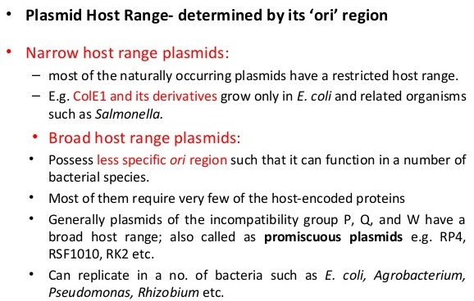

Slide 19
Conjugative/non-conjugative
Plasmid Size
Plasmid Copy Number
Plasmid Host Range
Plasmid Compatibility

Slide 20
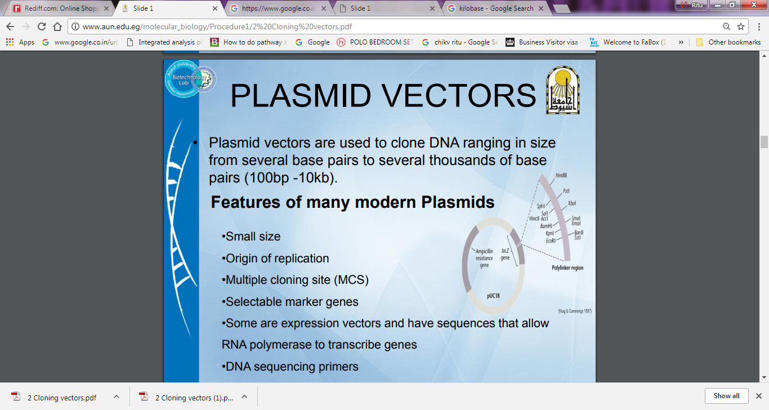

Slide 21
Markers (Antibiotic resistance)
Ampicillin (beta-lactam class) inhibits synthesis of bacterial cell wall
amp resistance depends upon production of an enzyme beta-lactamase, that catalyzes beta-lactam ring degradation in the periplasmic space.
Tetracycline binds to 30S subunit of the ribosome to prevent ribosome translocation tet resistance produces a protein that prevents tetracycline from entering the cell.
Chloramphenicol binds to the 50S subunit of the ribosome to prevent protein synthesis
cat (chloramphenicol resistance) produces an enzyme system component that converts chloramphenicol to a form that cannot bind the ribosome.
Kanamycin (and the closely related neomycin) are aminoglycosides that bind sub-components of the ribosome and prevent protein synthesis. kan (and neo) resistance depend upon the synthesis of an aminoglycoside phosphotransferase located in the periplasmic space that inhibits their transport into the cell.

Slide 22
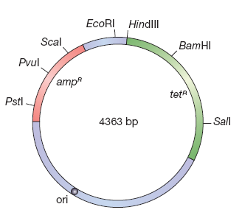
pBR322- One of the earliest plasmid cloning vector
pBR322 comprises DNA derived from three different naturally occurring plasmids.
The ampR gene originally resided on the plasmid R1, a typical antibiotic resistance plasmid that occurs in natural populations of E. coli
The tetR gene is derived from R6-5, a second antibiotic-resistant plasmid.
~15 copies/cell (may be increased to ~1000 by use of chloramphenicol)
The ori is originally from pMB1, which is closely related to the colicin-producing plasmid ColE1.
The name “pBR322” conforms with the standard rules for vector nomenclature:
“p” - plasmid.
“BR”- BR stands for Bolivar and Rodriguez, the two researchers who developed pBR322.
“322” distinguishes this plasmid from others developed in the same laboratory
(there are also plasmids called pBR325, pBR327, pBR328,

Slide 23
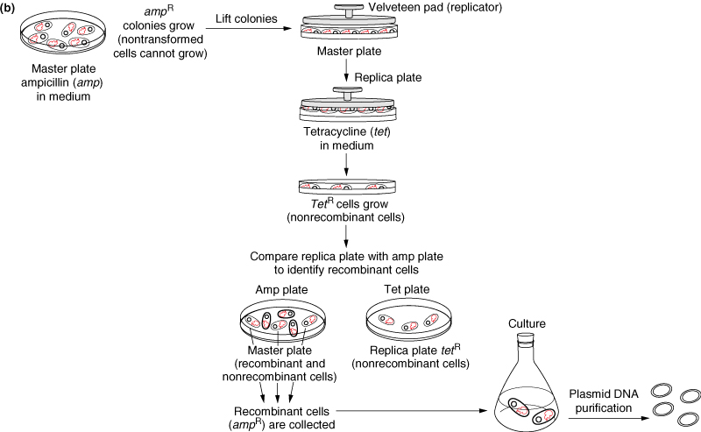
Screening bacteria by replica plating Eg. The cloning is performed in Bam HI Site
Clone fragment in one antibiotic gene and Select for other antibiotic resistance
Screen for presence of one resistance gene (selects against untransformed bacteria) and loss of resistance to interrupted antibiotic resistance gene (selects for recombinant molecule)
Notes:
In molecular biology and microbiology, replica plating is a technique in which one or more secondary Petri plates containing different solid (agar-based) selective growth media (lacking nutrients or containing chemical growth inhibitors such as antibiotics) are inoculated with the same colonies of microorganisms from a primary plate (or master dish), reproducing the original spatial pattern of colonies. The technique involves pressing a velvet-covered disk to a primary plate, and then imprinting secondary plates with cells in colonies removed by the velvet from the original plate. Generally, large numbers of colonies (roughly 30-300) are replica plated due to the difficulty in streaking each out individually onto a separate plate.
The purpose of replica plating is to be able to compare the master plate and any secondary plates to screen for a selectable phenotype. For example, a colony which appeared on the master plate but failed to appear at the same location on a secondary plate shows that the colony was sensitive to a substance on that particular secondary plate. Common screenable phenotypes include auxotrophy and antibiotic resistance.
Replica plating is especially useful for negative selection. For example, if one wanted to select colonies that were sensitive to ampicillin, the primary plate could be replica plated on a secondary Amp+ agar plate . The sensitive colonies on the secondary plate would die but the colonies could still be deduced from the primary plate since the two have the same spatial patterns from ampicillin resistant colonies. The sensitive colonies could then be picked off from the primary plate.
By increasing the variety of secondary plates with different selective growth media, it is possible to rapidly screen a large number of individual isolated colonies for as many phenotypes as there are secondary plates.
This technique was first described in the context of the Luria-Delbruck experiment in 1943.

Slide 24
pBR327
It was made by deleting a 1089 segment from pBR322
The Amp and Tet resistance genes were intact
Higher copy number ~30-45/E coli cell
The deletion also led to the loss of conjugation ability of the plasmid vector- (Important for Biological Containment)

Slide 25
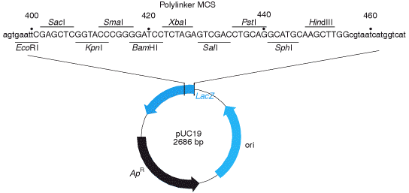
pUC vector series (pUC18/19)- Advanced Vectors
Inclusion of Polylinker (also called multiple cloning site) of ~ 60 bases which has sites for multiple restriction endonucleases
Have a region of the lacZ gene that codes for β-galactosidase. This region also contains a polylinker. Thus, insertion of a foreign DNA into any of the restriction sites results in an altered non-functional enzyme. Thus, facilitates Blue-White Screening
Shorter than pBR322 (due to removal of most of non-essential DNA) and thus can clone larger fragments
The name “pUC” conforms with the standard rules for vector nomenclature:
“p” - plasmid.
“UC”- stands for University of California where early work on the vector was conducted

Slide 26
The polylinker advantage
Unique sites (usually)
Insert excision facilitated
Restriction endonuclease mapping and Subcloning made easier
Directional cloning
Notes:
The designation "pUC" is derived from the classical "p" prefix (denoting "plasmid") and the abbreviation for the University of California, where early work on the plasmid series had been conducted. It is a circular double stranded DNA and has 2686 base pairs.

Slide 27
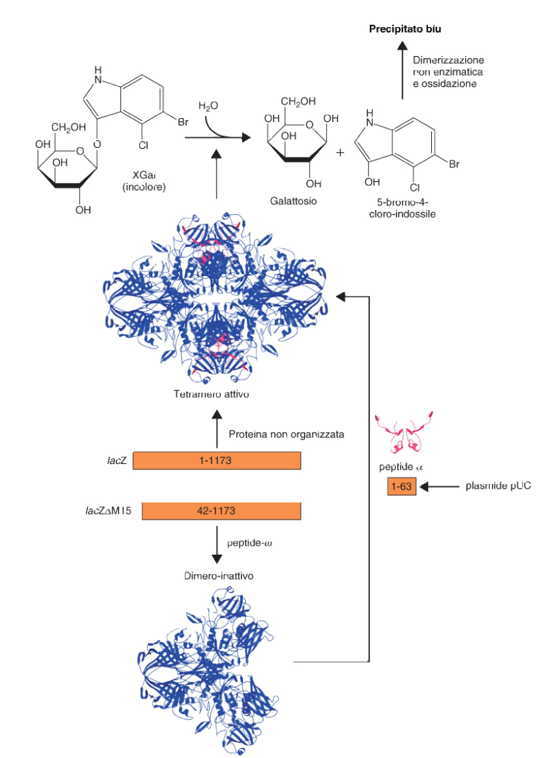
Blue White Screening-Alpha complementation:
LacZ→ Beta galactosidase
(Homotetramer)
1021aa
Bacteria carry mutant allele (LacZΔM15) lacking N-terminal domain → inactive protein
Alpha peptide carried by plasmid
Exploits X-Gal (5-bromo-4-cloro-3-indolil-Betagalattoside), a chromogenic substrate analog to galactose
MCS inserted into LacZ alpha peptide →
With insert = white colonies
Without insert = blue colonies

Slide 28
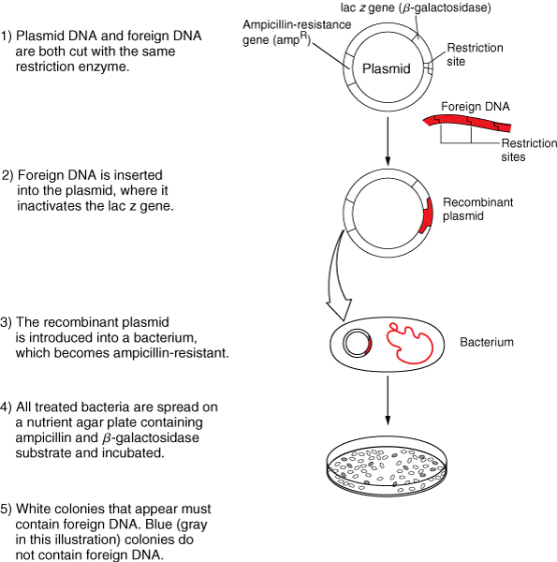
Another Major Advance: Blue-White Screening

Slide 29
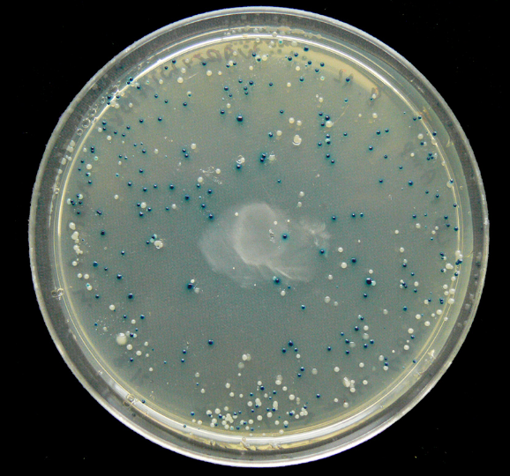
The blue colonies contain “self” religated plasmids that do not have DNA inserts interrupting the lac Z gene.
White colonies consist of bacteria that carry plasmids that have DNA insert fragments that interrupt the lac Z gene.
Beware False Positives:
Blue-white screening only indicates the presence of AN insert, not necessarily YOUR insert.
b) A small sequence of foreign DNA may be inserted into MCS and change the reading frame of lacZ gene. This results in false positive white colonies.

Slide 30
pUC8
500-700 copies/cell
(due to chance mutation in the ori)
Identification of recombinants (blue white screening)
Multiple Cloning Site (MCS)
Subcloning in M13 mp series vector easy
Notes:
https://plantcellbiology.masters.grkraj.org/html/Genetic_Engineering2A-Molecular_Tools-General_Vectors.htm

Slide 31
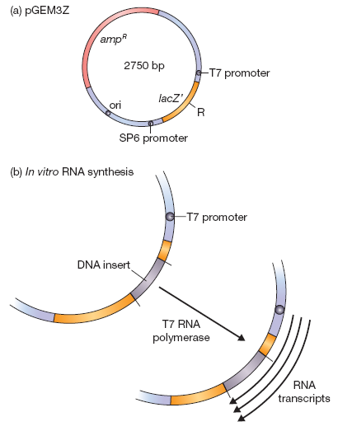
pGEM3Z—Introduction of promoter for in vitro transcription of cloned DNA
Identification of recombinants (blue white screening)
MCS
2 promoters for in vitro transcription or probe preparation
(phage promoters-T7 and SP6)
Notes:
The promoters carried by pGEM3Z and other vectors of this type are not the standard
sequences recognized by the E. coli RNA polymerase. Instead, one of the promoters is
specific for the RNA polymerase coded by T7 bacteriophage and the other for the RNA
polymerase of SP6 phage. These RNA polymerases are synthesized during infection of
E. coli with one or other of the phages and are responsible for transcribing the phage
genes. They are chosen for use in in vitro transcription as they are very active enzymes
– remember that the entire lytic infection cycle takes only 20 minutes, so the
phage genes must be transcribed very quickly. These polymerases are able to synthesize
1–2 mg of RNA per minute, substantially more than can be produced by the standard
E. coli enzyme.

